Slide 1

CHAI-TIME POS System
Complete POS Solution Master Plan

Slide 2
Introduction
This presentation summarizes the development of a comprehensive Point of Sale (POS) system tailored for single-shop cafes.
It covers the systems core objectives, design considerations, user roles, and technical architecture aimed at creating a secure, offline-capable, owner-controlled solution with real-time reporting and analytics.

Slide 3
01
Project Overview

Slide 4
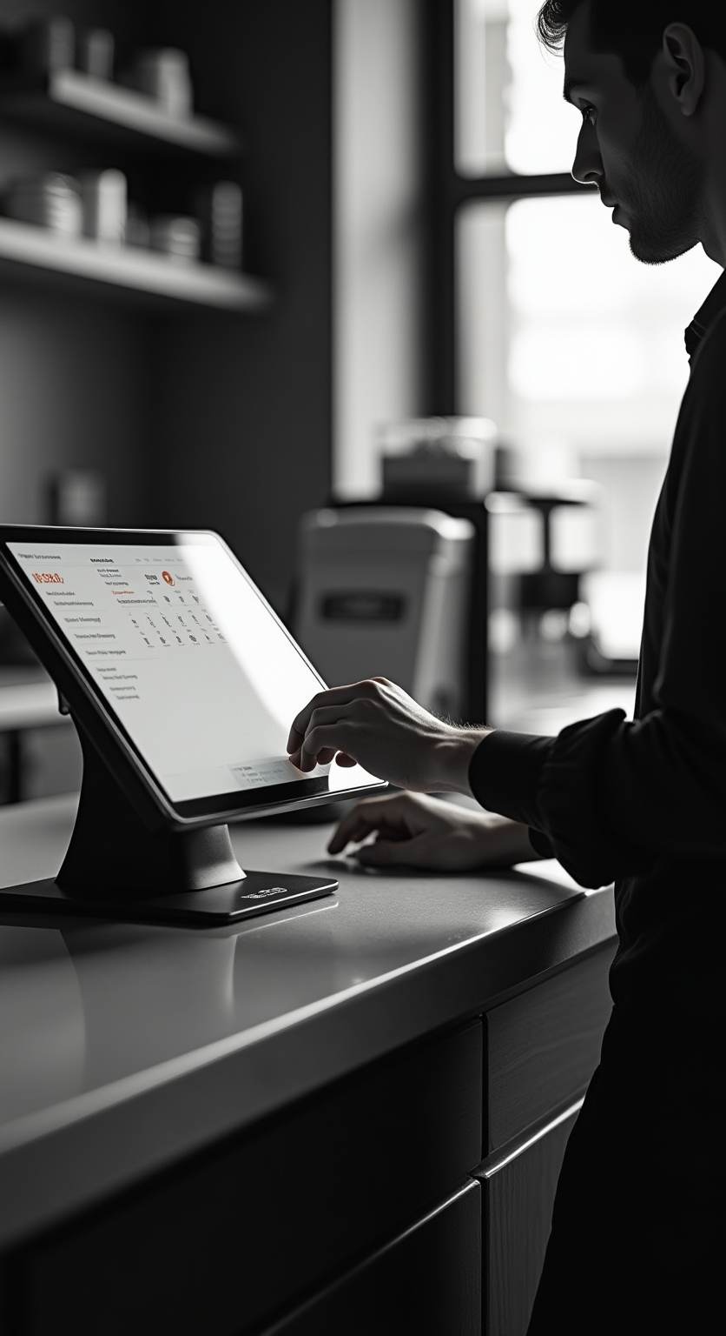
Title of the Project: CHAI TIME CAFE – COMPLETE POS SYSTEM MASTER PLAN
The project titled CHAI-TIME CAFE – COMPLETE POS SYSTEM MASTER PLAN focuses on developing an all-in-one POS system to streamline cafe operations.
It addresses current challenges such as security, offline functionality, and comprehensive owner control, ensuring efficient transaction management and detailed reporting.

Slide 5
Domain Name: Point of Sale Systems for Retail/Cafes
The domain centers on Point of Sale Systems for Retail and Cafes, targeting single-shop establishments.
Key features include cashier billing, real-time owner dashboards, shift management, secure payment processing, and data synchronization supporting both online and offline environments.

Slide 6
Problem Statement: Need for a fast, secure POS system with owner control, offline support, and real-time reporting
The project addresses the need for a fast and secure POS system tailored for single-shop cafes, emphasizing complete owner control with role-based access.
It supports offline operations ensuring business continuity, and provides real-time reporting for informed decision-making. Security features include audit logs and restricted access to sensitive functions.

Slide 7
02
System Features and Objectives

Slide 8
Objective: Build a single-shop mini cafe POS with cashier billing, full owner control, secure data, real-time reports, offline support, and investor-ready analytics
The objective is to develop a mini cafe POS system enabling fast billing by cashiers, while granting owners full control over items, cashiers, discounts, and reports.
The system ensures secure data management, supports offline syncing, and generates investor/bank-ready analytics with detailed operational insights.

Slide 9
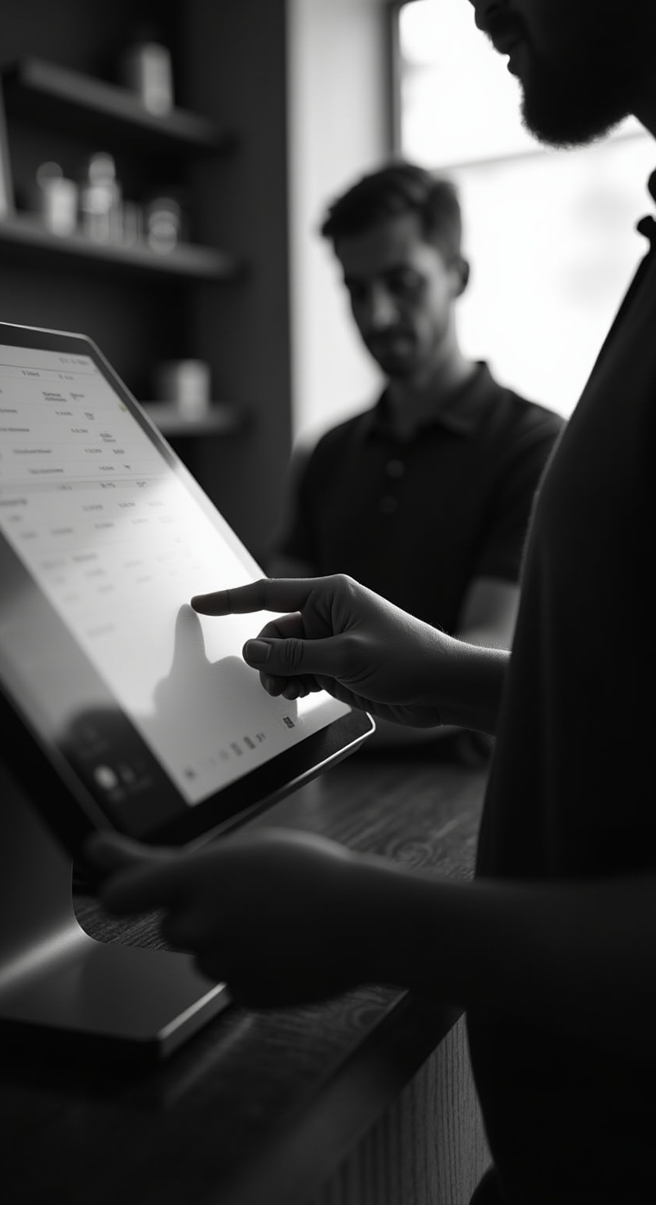
User Roles: Cashier with billing access, Owner/Admin with full dashboard and control
Users include Cashiers, who log in with passwords and can create bills but only view their own transactions.
Owners/Admins have secret access via a triple-tap logo, with a full dashboard to manage items, cashiers, discounts, reports, and audits, enforcing strict role-based access control.

Slide 10
Key Functionalities: Billing flow, payment modes (Cash, UPI), discount management, shift closing, offline mode
The system supports intuitive billing with item selection, payment modes including Cash and UPI, and secure payment confirmation.
Discounts are owner-controlled and fixed, with no access for cashiers. Shift closing summarizes cashier sales. Offline mode stores bills locally with auto-sync when back online.

Slide 11
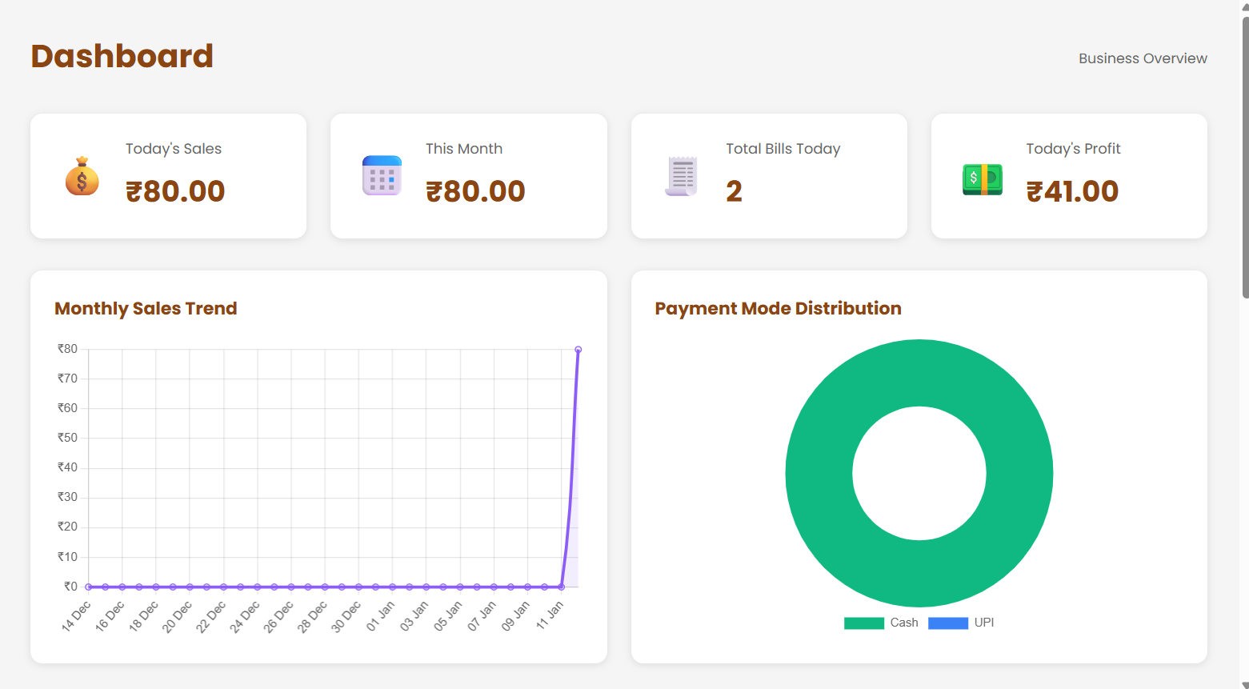
Conclusions
The POS system delivers a complete solution for single-shop cafes, combining fast billing, strong security, and comprehensive owner control.
Its offline capabilities and real-time reporting ensure operational continuity and transparency.
With investor-ready analytics and audit trails, it supports business growth and compliance requirements effectively.

Slide 12
THANK YOU
Please keep this slide for attribution

